Slide 1
Chapter 4 Transients (暫態)
藉由 switch 開關突然對電路提供source 所造成的隨時間改變(時變, time-varying) 的電流或電壓稱為暫態(transients).
其電路方程式為積分微分方程式(integrodifferential equations).

Slide 2
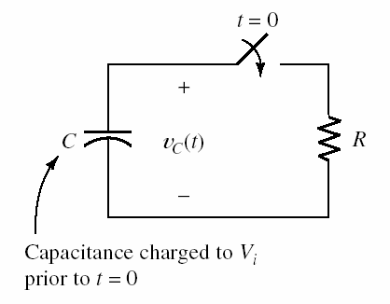
4.1 1st-Order RC Circuits
Discharge of a Capacitance through a Resistance
At t<0, the capacitor is charged to an initial voltage V_{i.}
Switch closes at t=0, current flows through the resistor, discharging the capacitor.
Find v_{C}(t)

Slide 3


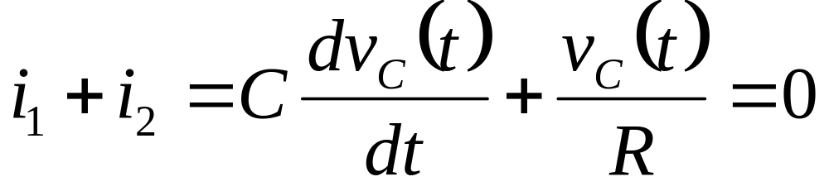
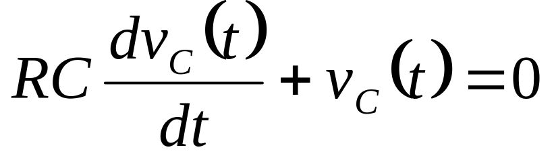
Discharge of a Capacitance through a Resistance
1. t<0, v_{C}(t) = V_{i}.
2. t = 0₊, Switch just closes
電容電壓continuous(不可有瞬間的變化)。
v_{C}(0₊) = V_{i}.
3. t > 0
KCL
(等號兩邊乘R)

Slide 4
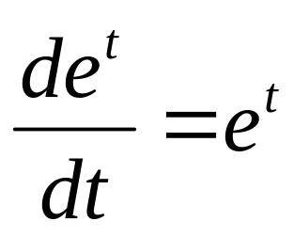
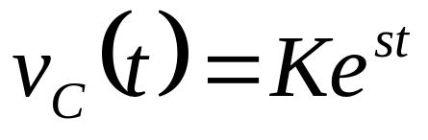
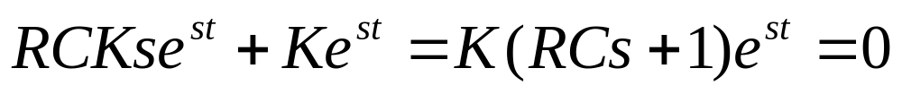
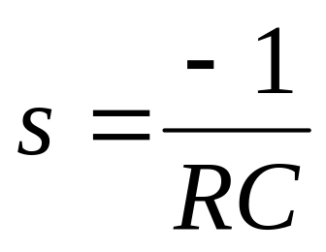
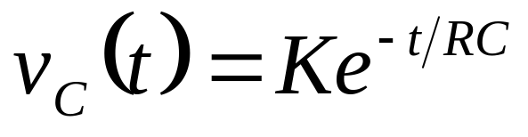
Recall
預期
代入
0

Slide 5

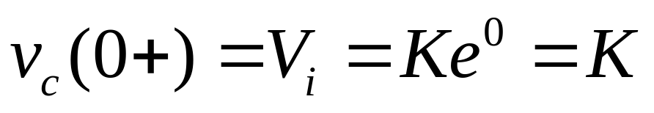
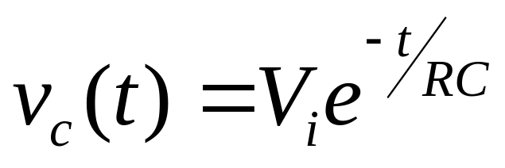
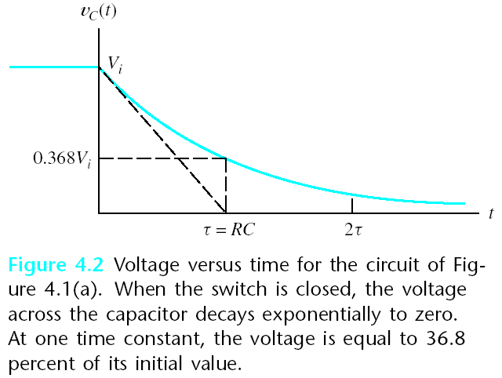
v_{C}(0₊) = V_{i}.

Slide 6
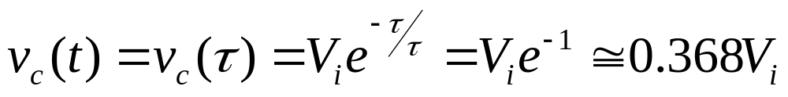
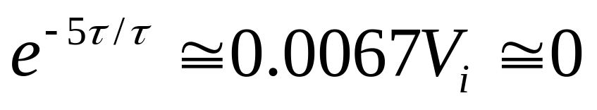
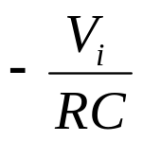
Time constant (時間常數) τ = RC
At t =τ = RC
RC 電路電容放電至初始電壓36.8% 所需時間
At t =5τ,
斜率

Slide 7
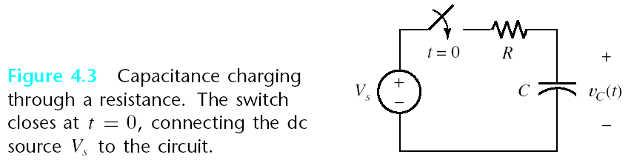
Charge a Capacitance from a DC source through a Resistance
Source voltage Vs is constant (a dc source).
Assume v_{C}(0－)=0.
Switch closes at t=0, current flows through the resistor, charging the capacitor.
Find v_{C}(t)

Slide 8
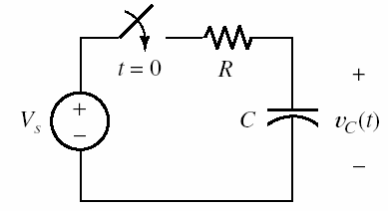

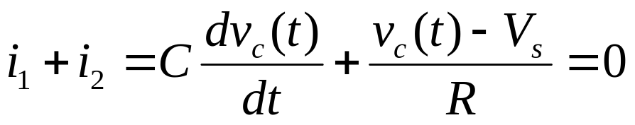
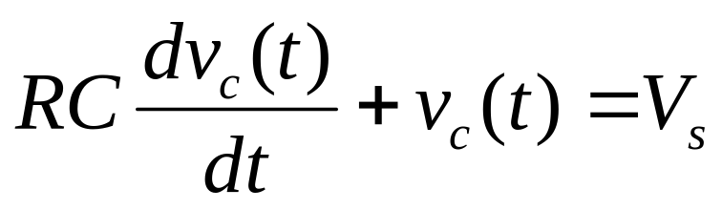
Charge a Capacitance from a DC source through a Resistance
1. t = 0₊, Switch just closes
電容電壓continuous(不可有瞬間的變化)
2. t > 0
KCL
(等號兩邊乘R)

Slide 9
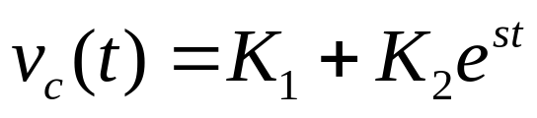
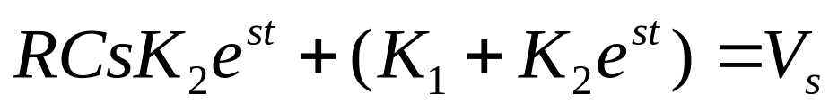
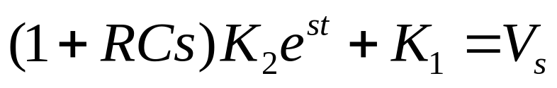
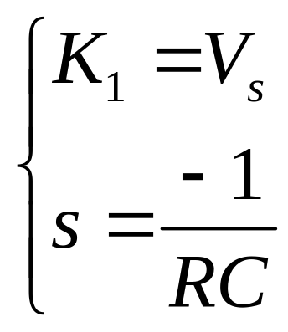
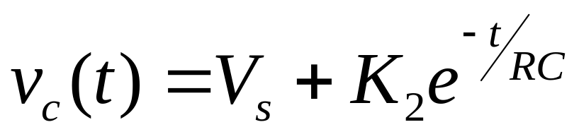
Charge a Capacitance from a DC source through a Resistance
多了一項V_{s}
預期
代入
0

Slide 10
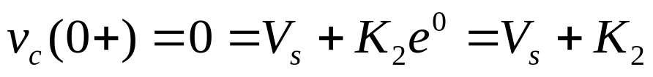
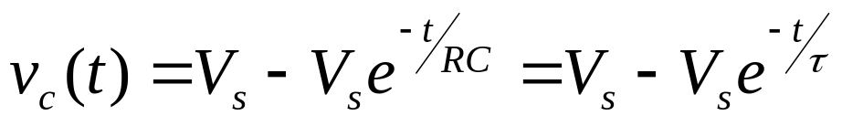
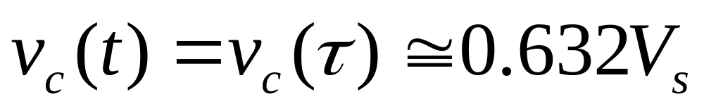
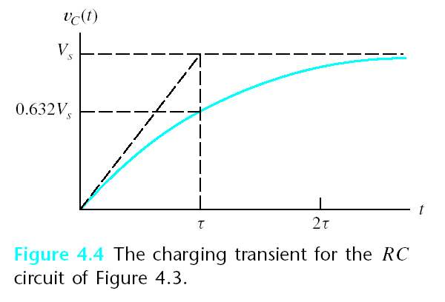
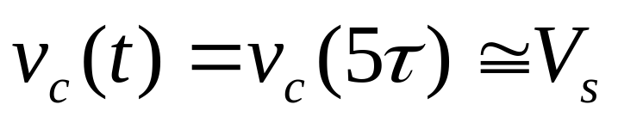
Transient
response
(暫態響應)
Steady-state
response or forced response (穩態響應)
At t =τ = RC
RC 電路電容充電
至dc電壓63.2% 所需時間
At t =5τ,

Slide 11
由於電容充放電需要數個time constant的時間(ex 5τ )，使得RC transients (RC 暫態)成為限制數位系統反應速度的主要原因。

Slide 12
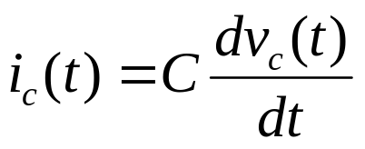
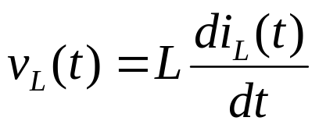
4.2 DC STEADY STATE (DC 穩態)
在dc source 下，RLC 電路的暫態項(transient terms) 會隨著時間而減低至0。
因此在穩態(steady-state)時，流過電容的電流為0，電容可視為斷路(open circuits) 。
在穩態(steady-state)時，電感兩端的電壓為0，電感可視為短路(short circuits) 。
0
0

Slide 13
4.2 DC STEADY STATE (DC 穩態)
The steps in determining the forced response for RLC circuits with dc sources are:
1. Replace capacitances with open circuits.
2. Replace inductances with short circuits.
3. Solve the remaining circuit.

Slide 14
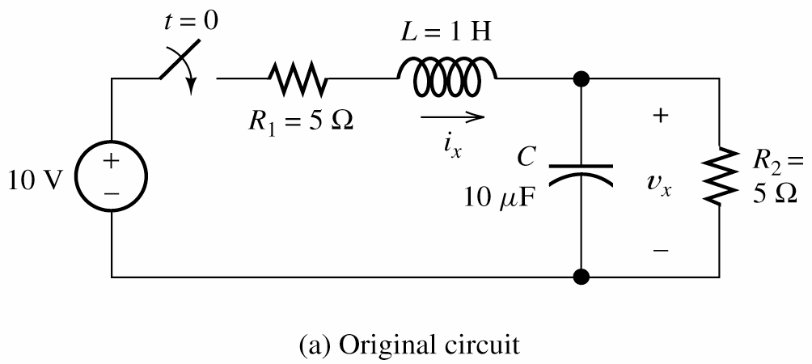
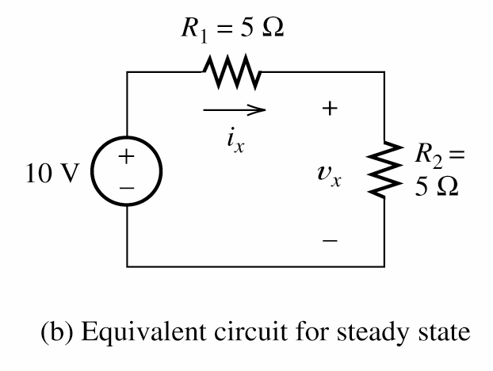
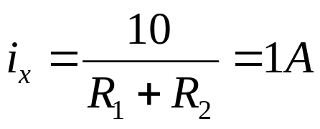

Example 4.1 Steady-state DC Analysis
short
open
Equivalent circuit for steady state

Slide 15
4.3 RL CIRCUITS
與RC Circuit 類似，探討包含dc sources, resistances 及一個電感的電路特性。
RL or RC 電路分析步驟歸納如下：
1. Apply Kirchhoff’s current and voltage laws to write the circuit equation.(RC: KCL, RL: KVL)
2. If the equation contains integrals,
differentiate each term in the equation to produce a pure differential equation.

Slide 16
3. Assume a solution of the form K₁ + K₂e^{st}.
4. Substitute the solution into the
differential equation to determine the values of K₁ and s . (Alternatively, we can determine K₁ by solving the circuit in steady state as discussed in Section 4.2.)

Slide 17
5. Use the initial conditions to determine the value of K₂.
6. Write the final solution.

Slide 18
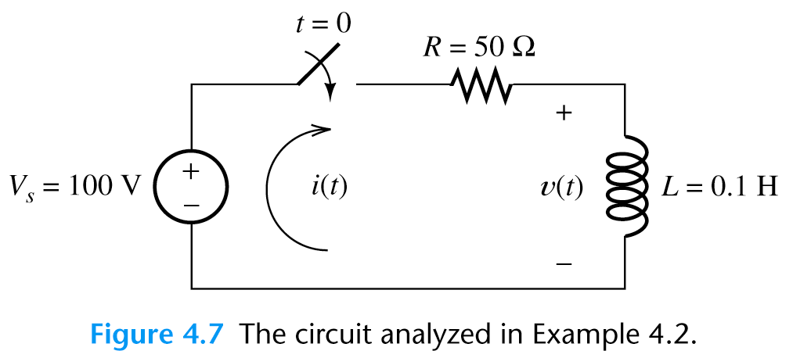
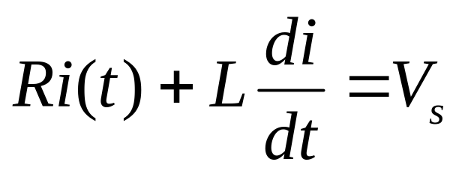
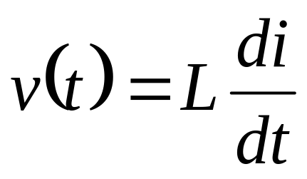
Example 4.2 RL Transient Analysis
1. t<0, i(t) = 0.
2. t > 0
KVL
( )

Slide 19
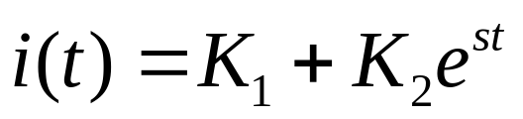
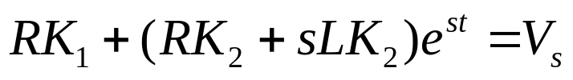
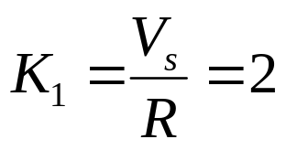
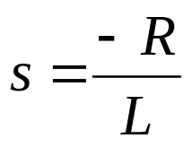
Example 4.2 RL Transient Analysis
Assume

Slide 20
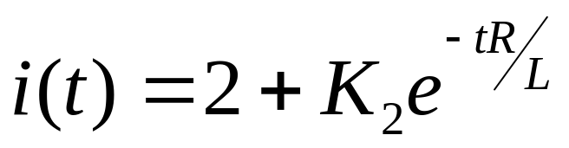
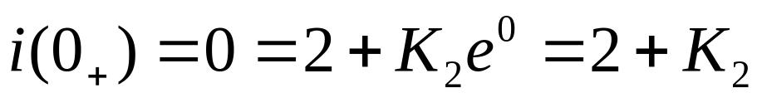
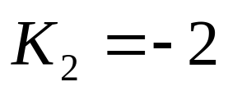
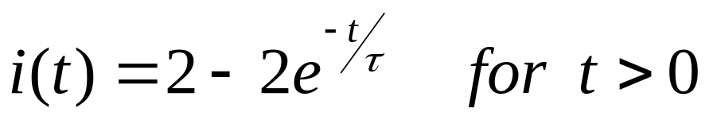
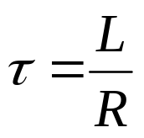
Example 4.2 RL Transient Analysis

Slide 21
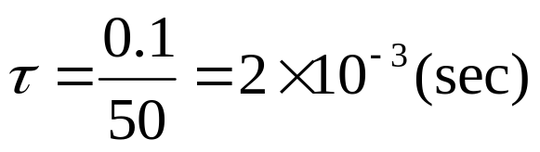
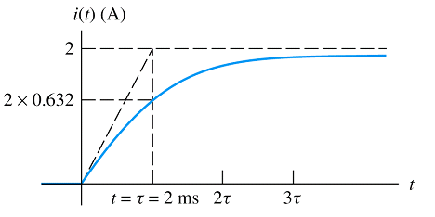
Example 4.2 RL Transient Analysis

Slide 22
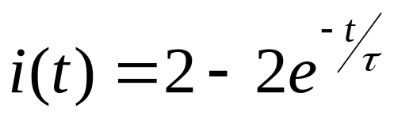
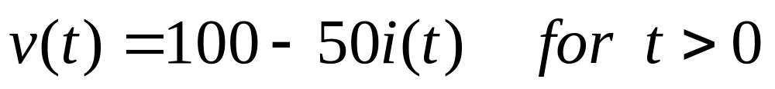
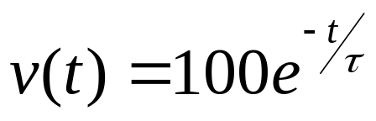


Example 4.2 RL Transient Analysis
Consider the voltage
1. t<0, v(t) = 0.
2. t > 0
( )
or

